Slide 1
Efficient Hardware Implementation using SPICE Model for DRAM and LIF Neuron
Presenter: Subbaiah Ravi Hariprakash
m5282026
15/4/2025

Slide 2
Research Goal
Use SPICE model to implement DRAM
Change voltage and observe results
Check error rate and accuracy
Implement LIF neuron and observe changes

Slide 3
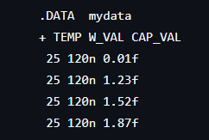
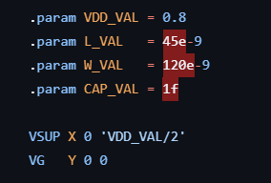
DRAM using HSPICE
Using HSPICE, a DRAM model can be designed and simulated
Input parameters are generated
With set parameters, simulation is done
Results are obtained

Slide 4
Monte Carlo Simulation
1000 trials are done using random threshold values to simulate statistical variability
Voltage is varied with Gaussian distribution
The Retention Time Limit (RTL) is measured
With the obtained RTL values, a histogram is plotted

Slide 5
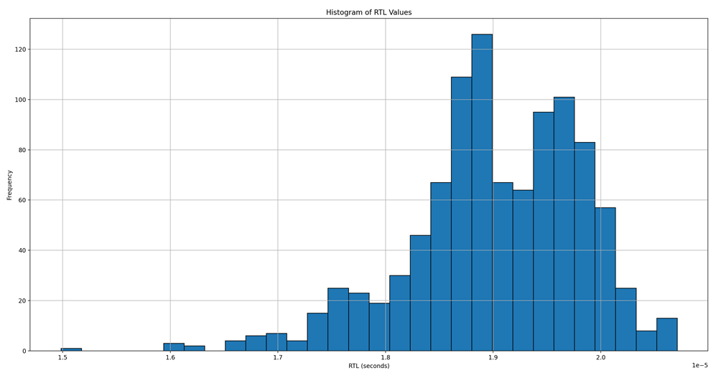
Histograms
1V
Trials with RTL > 2 seconds: 78
Trials with RTL <= 2 seconds: 922
Error: 92.2%

Slide 6
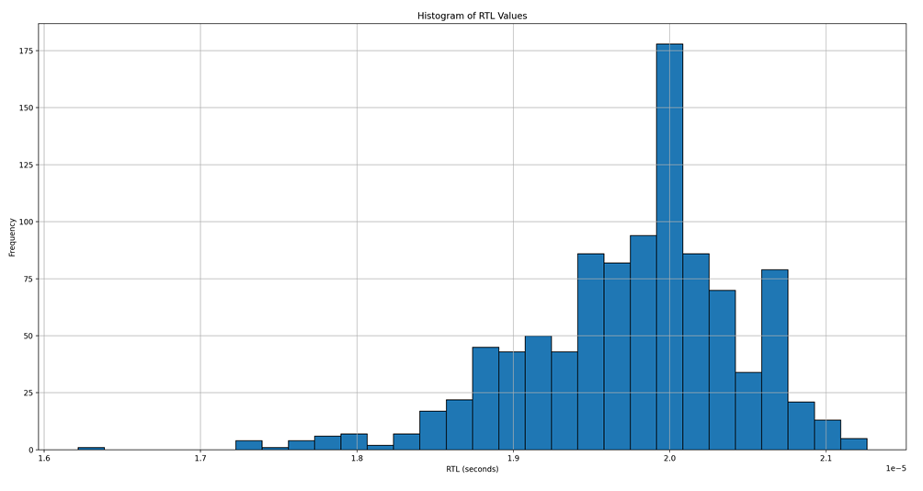
Histograms
1.05V
Trials with RTL > 2 seconds: 389
Trials with RTL <= 2 seconds: 611
Error: 61.1%

Slide 7
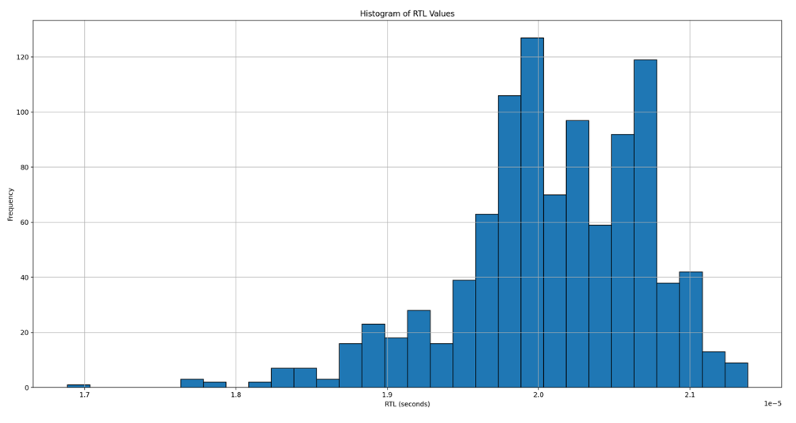
Histograms
1.075V
Trials with RTL > 2 seconds: 568
Trials with RTL <= 2 seconds: 432
Error: 43.2%

Slide 8
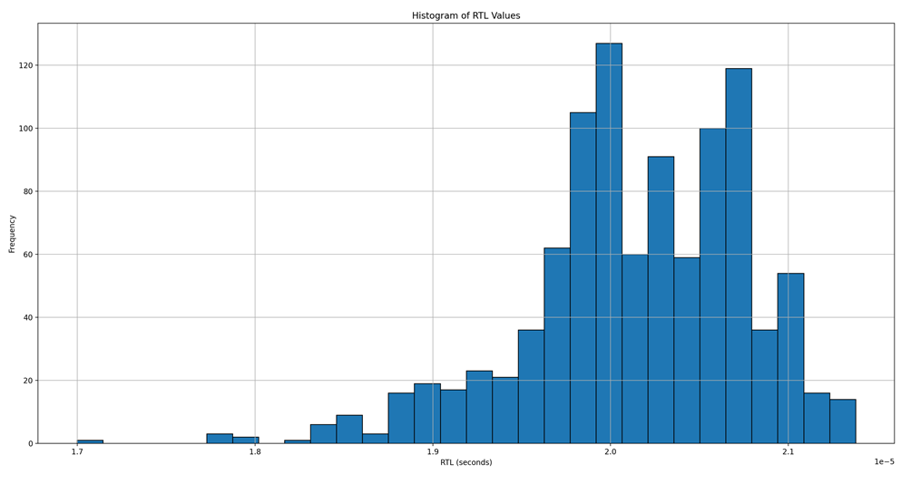
Histograms
1.08V
Trials with RTL > 2 seconds: 608
Trials with RTL <= 2 seconds: 392
Error: 39.2%

Slide 9
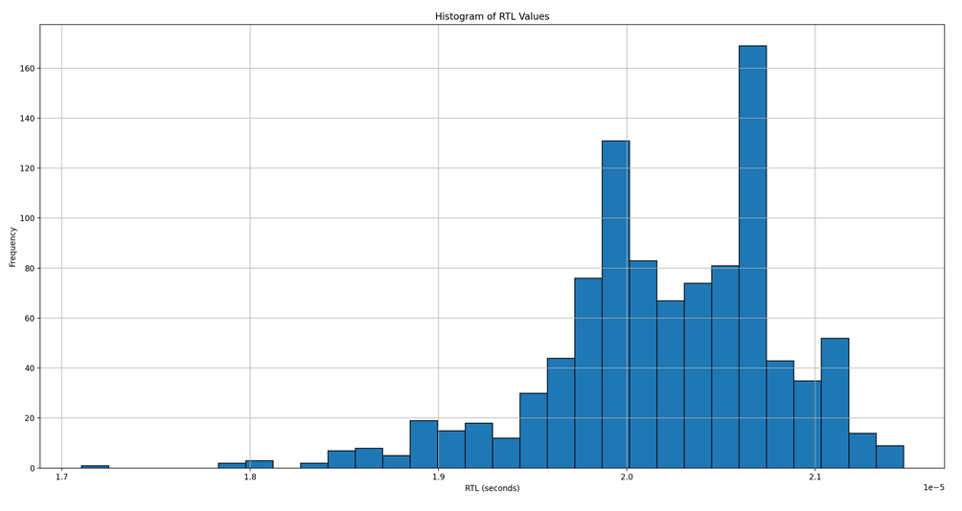
Histograms
1.085V
Trials with RTL > 2 seconds: 639
Trials with RTL <= 2 seconds: 361
Error: 36.1%

Slide 10
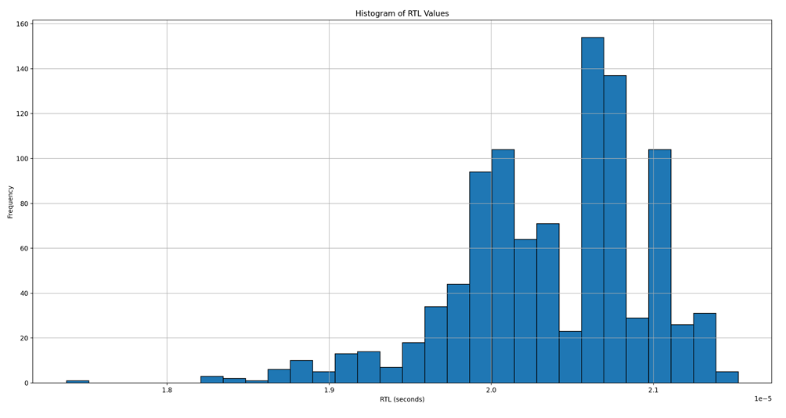
Histograms
1.1V
Trials with RTL > 2 seconds: 752
Trials with RTL <= 2 seconds: 248
Error: 24.8%

Slide 11
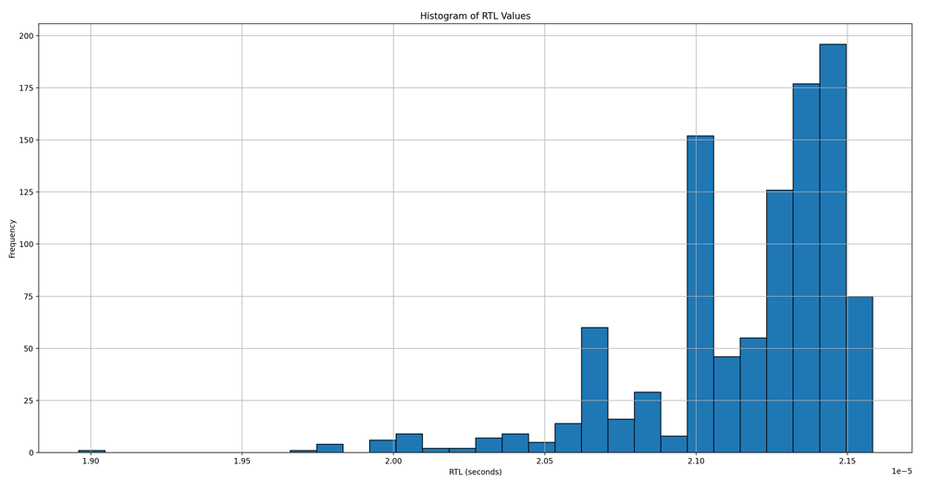
Histograms
1.2V
Trials with RTL > 2 seconds: 990
Trials with RTL <= 2 seconds: 10
Error: 10%

Slide 12
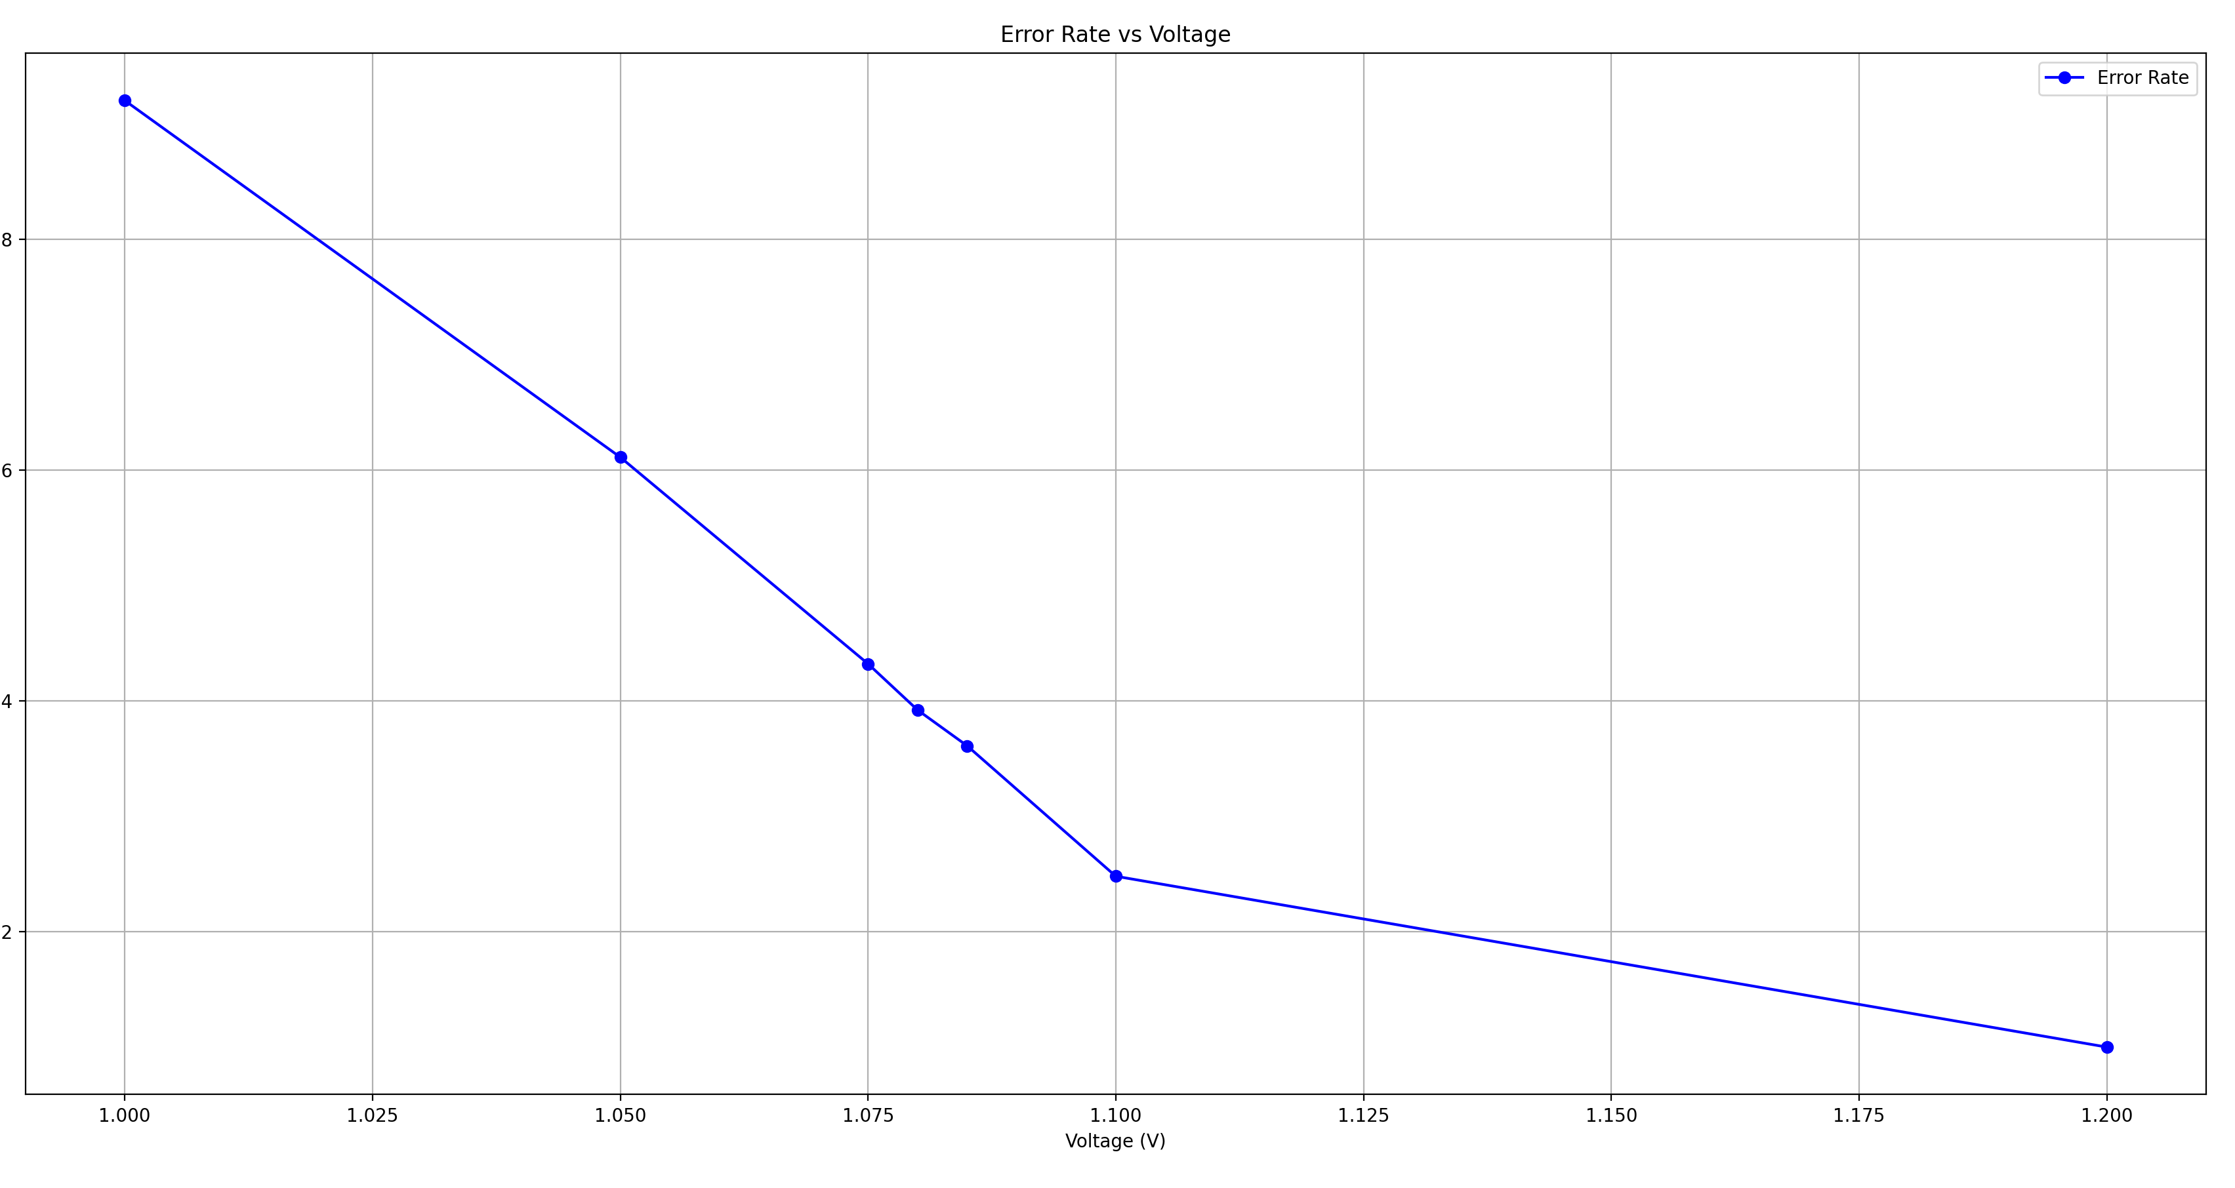
Voltage vs Error Rate

Slide 13
LIF Neuron
The Leaky Integrate and Fire (LIF) Neuron mimics a biological neuron.
It integrates input signals and leaks energy over time.
When the stored energy passes a threshold, it fires a spike.
After the spike, it resets.

Slide 14
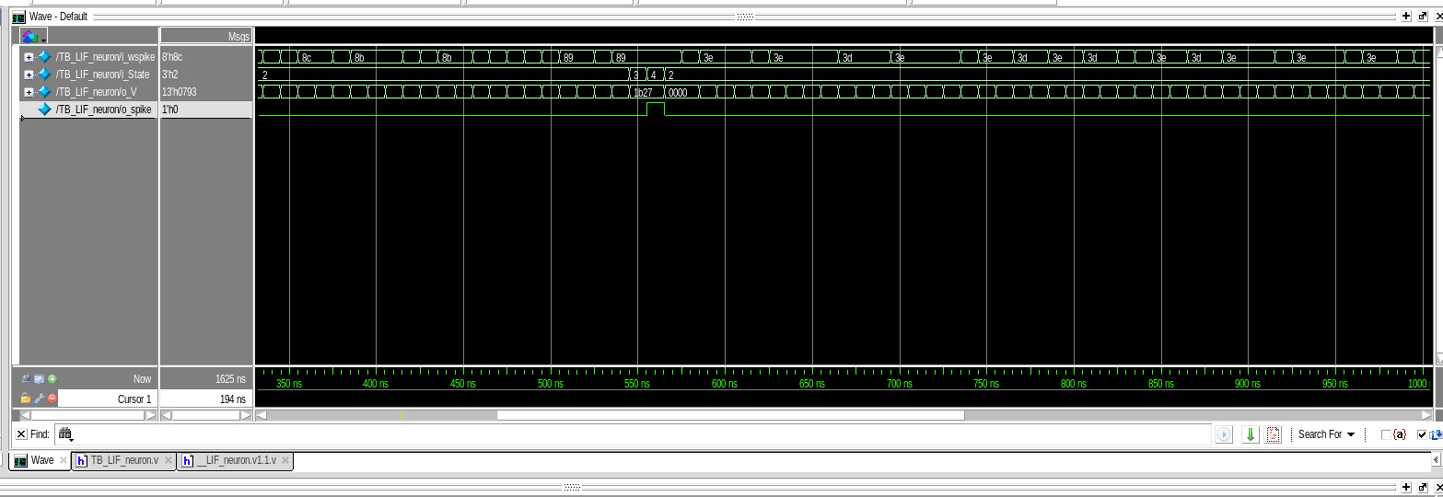
LIF Neuron - Working
Input spikes are being applied.
Once a certain point has been reached, the state changes.
The membrane potential increases until spike has been fired.
Once the spike fires it resets.

Slide 15
Research Progress On-going: eDRAM using HSPICE and LIF Neuron
Lowering voltage changes error rate
Error rate for different parameters must be found
Read and write power consumption must be found
LIF neuron’s voltage must be changed to find its performance.

Slide 16
Schedule
Time Task | May 2025 | Jun 2025 | July 2025
Find error for different parameters
Find read / write power consumption
Find performance of LIF neuron and DRAM

Slide 17
References
[1] R. Kobayashi and K. N. Dang, "An Efficient Hardware Implementation of Spiking Neural Network Using Approximate Izhikevich Neuron," 2024 9th International Conference on Integrated Circuits, Design, and Verification (ICDV), Hanoi, Vietnam, 2024, pp. 13-18, doi: 10.1109/ICDV61346.2024.10616602.
[2] Ryoji Kobayashi, Ngo-Doanh Nguyen, Nguyen Anh Vu Doan and Khanh N. Dang, '’Energy-Efficient Spiking Neural Networks Using Approximate Neuron Circuits and 3D Stacking Memory’‘, 2024 IEEE 17th International Symposium on Embedded Multicore/Many-core Systems-on-Chip (MCSoC), Dec. 16-19, 2024.
[3] Du, Y. Decentralized Smart IoT. Encyclopedia. Available online: https://encyclopedia.pub/entry/8977 (accessed on 22 November 2022).
[4] S. H. Tsang, https://towardsdatascience.com/review-refinenet-multi-path-refinement- network-semantic-segmentation-5763d9da47c1
[5] John L. Hennessy, David A. Patterson, A New Golden Age for Computer Architecture, Communications of the ACM, February 2019, Vol. 62 No. 2, Pages 48-60, 10.1145/3282307

Slide 18
References
[6] A. Ben, K. N, Dang, Neuromorphic Computing Principles and Organization, Springer, 2022
[7] F. Akopyan et al., "TrueNorth: Design and Tool Flow of a 65 mW 1 Million Neuron Programmable Neurosynaptic Chip," in IEEE Transactions on Computer-Aided Design of Integrated Circuits and Systems, vol. 34, no. 10, pp. 1537-1557, Oct. 2015, doi: 10.1109/TCAD.2015.2474396.
[8] M. Davies et al., "Loihi: A Neuromorphic Manycore Processor with On-Chip Learning," in IEEE Micro, vol. 38, no. 1, pp. 82-99, January/February 2018, doi: 10.1109/MM.2018.112130359.
[9] B. V. Benjamin et al., "Neurogrid: A Mixed-Analog-Digital Multichip System for Large-Scale Neural Simulations," in Proceedings of the IEEE, vol. 102, no. 5, pp. 699-716, May 2014, doi: 10.1109/JPROC.2014.2313565.
[10] B. Vaidyanathan, W.-L. Hung, F. Wang, Y. Xie, V. Narayanan, and M. J. Irwin, “Architecting microprocessor components in 3d design space,” in 20th International Conference on VLSI Design, 2007. Held Jointly with 6th International Conference on Embedded Systems., pp. 103–108, IEEE, 2007.
[11] N. -D. Nguyen, A. B. Ahmed, A. B. Abdallah and K. N. Dang, "Power-Aware Neuromorphic Architecture With Partial Voltage Scaling 3-D Stacking Synaptic Memory," in IEEE Transactions on Very Large Scale Integration (VLSI) Systems, vol. 31, no. 12, pp. 2016-2029, Dec. 2023, doi: 10.1109/TVLSI.2023.3318231

Slide 19
Thank You

